Slide 1

Overview of Graph Database Management Systems
Semih Salihoğlu

Slide 2






Quick Bio
Assoc. Prof. at UWaterloo. Part of Data Systems Group
Co-founder of Kùzu, Inc (https://github.com/kuzudb/kuzu)
Develops Kùzu graph DBMS

Slide 3
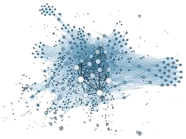
What are Graphs/Networks?
One of the most natural data structures to represent
enterprise application data.
Facilitates “more” object-oriented modeling than relations.
Relationship
Entity A
Entity B

Slide 4
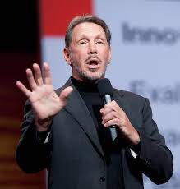

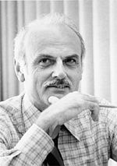
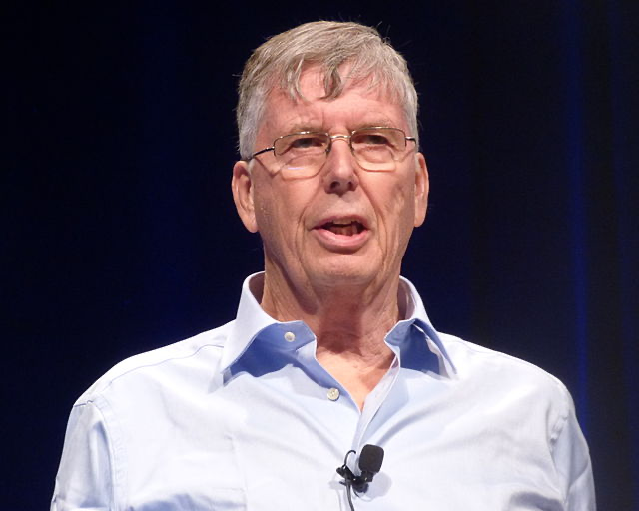

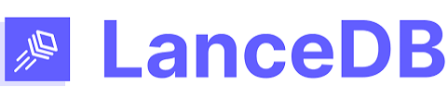





A Lightning Fast History of DBMSs
Integrated Data Store (IDS)
Information
Management System
(IMS)
Ted Codd’s Relational Model
(System R)
Larry Ellison’s Oracle RDBMS
Stonebraker’s Ingres/Postgres RDBMS
1960s
1970s
1980s
2020s
2010s
2000s
1990s
Vector
DBMSs ?
Document-oriented DBMSs
RDF DBMSs
Columnar/OLAP
RDBMSs
Object Oriented DBMSs
Property Graph DBMSs
XML DBMSs

Slide 5


Two Popular Modern Graph Data Models
Property Graphs
RDF
labels
&
properties
labels & attributes
labels
&
properties
predicate
subject
object

Slide 6
Outline
Property Graphs Overview
RDF Overview

Slide 7
Outline
Property Graphs Overview
RDF Overview

Slide 8
Property Graph Data Model
Account
ID | owner | ctry
111 | Alice | CA
222 | Carol | USA
333 | Bob | CA
eTransfer
from | to | amount
111 | 222 | $700
222 | 333 | $800
111 | 333 | $400
wire
from | to | amount
222 | 111 | $200
eft
from | to | amount
111 | 333 | $500
Account
ID: 111
owner:Alice
ctry: CA
wire
amnt: $200
eft
amnt: $500
eTransfer
amnt: $700
eTransfer
amnt: $400
Account
ID: 222
owner:Carol
ctry: USA
Account
ID: 333
owner: Bob
ctry: CA
eTransfer
amnt: $800

Slide 9
Property Graph Database Query Languages
FROM
MATCH (a:Account)-[t:eTransfer]->(b:Account)
WHERE a.owner = Alice
RETURN b.owner, average(t.amount) AS avg
WHERE
SELECT
SQL-like
b.owner | avg
Bob | 400
Carol | 700
Specialized syntax & functions for graphs
a
t
b
Account
owner:Alice
eTransfer
Account
path patterns

Slide 10
Path Patterns & Path Data Type
MATCH p = (a:Account)-[t1:eTransfer]->(b:Account)-[t2:eTransfer]->(c:Account),
(c)-[t3:eTransfer]->(d:Account)
WHERE a.owner = Alice AND is_acyclic(p)
RETURN p
a
t1
b
t2
c
t3
d
Account
owner:Alice
eTransfer
eTransfer
eTransfer
Account
Account
Account
X
p
…
Alice
Bob
Carl
Dan

Slide 11
Most Popular Question About GDBMSs
Differences between GDBMSs and RDBMSs?
From a user’s perspective:
Recursive Queries
Flexible join sequences
Querying patterns
Graph algorithms & entity-oriented questions
Modeling complex & irregular domains
From a system implementation perspective:
Predefined joins
Techniques for recursive joins
Techniques for growing joins
Will go through exercises in the last session
Will discuss
in the RDF part

Slide 12
Most Popular Question About GDBMSs
Differences between GDBMSs and RDBMSs?
From a user’s perspective:
Recursive Queries
Flexible join sequences
Querying patterns
Graph algorithms & entity-oriented questions
Modeling complex & irregular domains
From a system implementation perspective:
Predefined joins
Techniques for recursive joins
Techniques for growing joins

Slide 13
1. Recursive querying & notion of path
“Give me all direct or indirect eTransfer money flows into Alice’s account from Canada.”
Aisha
cnty:CA
eTransfer
Alice
cnty:US
eTransfer
eTransfer
Ken
cnty:CA
eTransfer
Xi
cnty:US
MATCH p = (b:Account)-[t:eTransfer*]->(a:Account)
WHERE b.location=Canada AND a.owner=Alice
RETURN p
Aisha
cnty:CA
eTransfer
Alice
cnty:US
Ken
cnty:CA
eTransfer
Xi
cnty:US
eTransfer
Alice
cnty:US
Aisha
cnty:CA
eTransfer
Ken
cnty:CA
eTransfer
Xi
cnty:US
eTransfer
Alice
cnty:US

Slide 14
1. Recursive querying & notion of path
“Give me all shortest flows of eTransfer money into Alice’s account from Canada.”
MATCH p = (b:Account)-[t:eTransfer* SHORTEST]->(a:Account)
WHERE b.location=Canada AND a.owner=Alice
RETURN nodes(p)
Recursive queries are objectively harder to formulate in SQL
Part of simplified query to find all the sources b (not paths)
WITH RECURSIVE AllFlows(from, country) AS (
SELECT DISTINCT from, country
FROM eTransfer, Account
WHERE Account.ID = eTransfer.to AND Account.owner=Alice
UNION
SELECT DISTINCT eTransfer.from
FROM AllFlows, eTransfer
WHERE AllFlows.from = eTransfer.to) As FinalFlows
// One final query to select data from FinalFlows

Slide 15
2. Flexible join sequences
“Give me all flows of money into Alice’s account from Canada.”
Bob
cnty:CA
eTransfer
Xi
cnty:US
wire
Alice
Aisha
cnty:CA
eft
Ken
cnty:CA
wire
Xi
cnty:US
eTransfer
Alice
MATCH p = (b:Account)-[t:*]->(a:Account)
WHERE b.location=Canada AND a.owner=Alice
RETURN p

Slide 16
2. Flexible join sequences
“Give me all flows of money into Alice’s account from that consist of eTransfer or wire transfers Canada.”
MATCH p = (b:Account)-[t:eTransfer|:wire*]->(a:Account)
WHERE b.location=Canada AND a.owner=Alice
RETURN p
In SQL would need to write a separate query for each possible join sequence (for each possible depth)

Slide 17





3. Querying patterns in data
some path
x1 < $100
y1 < x1
> $100000
x3 < $100
y3 < x3
some path
MATCH (a:Account)-[x1]->(b1:Account)-[y1]->(c:Account),
(a)-[x2]->(b2:Account)-[y2]->(c),
(a)-[x3]->(b3:Account)-[y2]->(c)
WHERE x1.amount < 100 AND … AND x3.amount < 100
y1.amount < x1.amount AND … AND y3.amount < x3.amount RETURN *

Slide 18
4. Graph algorithms & entity-oriented questions
“Who are my most important/central users?”
ranking & centrality algorithms
“Find the community of users that Alice belongs to?”
community detection algorithms
“Which users should I promote my ad campaign to?”
influence maximization algorithms

Slide 19
4. Graph algorithms & entity-oriented questions
WITH project((a:User)-[f:Follows]->(b:User)) as g
CALL algs.pageRank(g)
YIELD node, pageRank
WITH project((a:Account)-[t:eTransfer]->(b:Account)) AS g
CALL algs.GraphSage(g)
YIELD node, embedding
Node Embeddings
f( )=

Slide 20
Most Popular Question About GDBMSs
Differences between GDBMSs and RDBMSs?
From a user’s perspective:
Recursive Queries
Flexible join sequences
Querying patterns
Graph algorithms & entity-oriented questions
Modeling complex & irregular domains
From a system implementation perspective:
Predefined joins
Techniques for recursive joins
Techniques for growing joins
Will discuss
in the RDF part

Slide 21
Most Popular Question About GDBMSs
Differences between GDBMSs and RDBMSs?
From a user’s perspective:
Recursive Queries
Flexible join sequences
Querying patterns
Graph algorithms & entity-oriented questions
Modeling complex & irregular domains
From a system implementation perspective:
Predefined joins
Techniques for recursive joins
Techniques for growing joins

Slide 22
“Summary of Differences in System Implementations
Property graph DBMSs are optimized for applications such as:
Fraud and threat detection
Recommendations
Pattern & path searching over many-to-many (m-n) relationships
Law of m-n joins: exponential growth in search space
Fast, specialized joins & techniques for mitigating growths

Slide 23

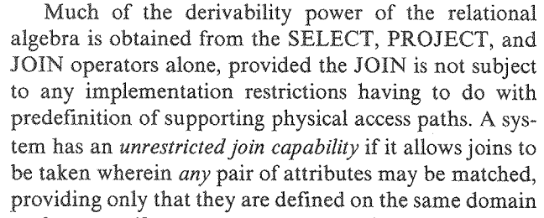
Pre-defined joins vs Value-based Joins
Network Model (1960s)
IDS: First DBMS in history
Relational Model (1970s)
Charles Bachman
Ted Codd
… but also the reason GDBMSs can be very fast at those joins.

Slide 24
Pre-defined joins vs Value-based Joins
Modern GDBMSs still support prejoining node records w/ each other:
Not a restriction
Optimization to be fast at common joins: constant-time access to prejoined nbrs
MATCH (p:Person), (c:Country)
WHERE p.cntrCode = c.code
RETURN c.pop
MATCH (p:Person)-[:LivesIn]->(c:Country)
RETURN c.pop
SELECT c.pop
FROM Person p, Country c
WHERE p.cntrCode = c.code
Person
name: Alice
ctryCode: CA
Person
name: Bob
ctryCode: CA
Person
name: Carl
ctryCode: USA
LivesIn
LivesIn
LivesIn
Country
code: CA
pop:40M
Country
code: USA
pop:333M

Slide 25
Pre-defined joins vs Value-based Joins
Optimizations: Join index and fast integer recordID-based joins
P0
P1
P2
Person
record IDs
Country
record IDs
Person
name: Alice
ctryCode: CA
Person
name: Bob
ctryCode: CA
Person
name: Carl
ctryCode: USA
0
1
2
0
0
LivesIn
LivesIn
LivesIn
1
“Forward” LivesIn Index
Country
code: CA
Country
code: USA
Country
record IDs
Person
record IDs
C0
C1
0
1
0 | 1
2
“Backward” LivesIn Index

Slide 26
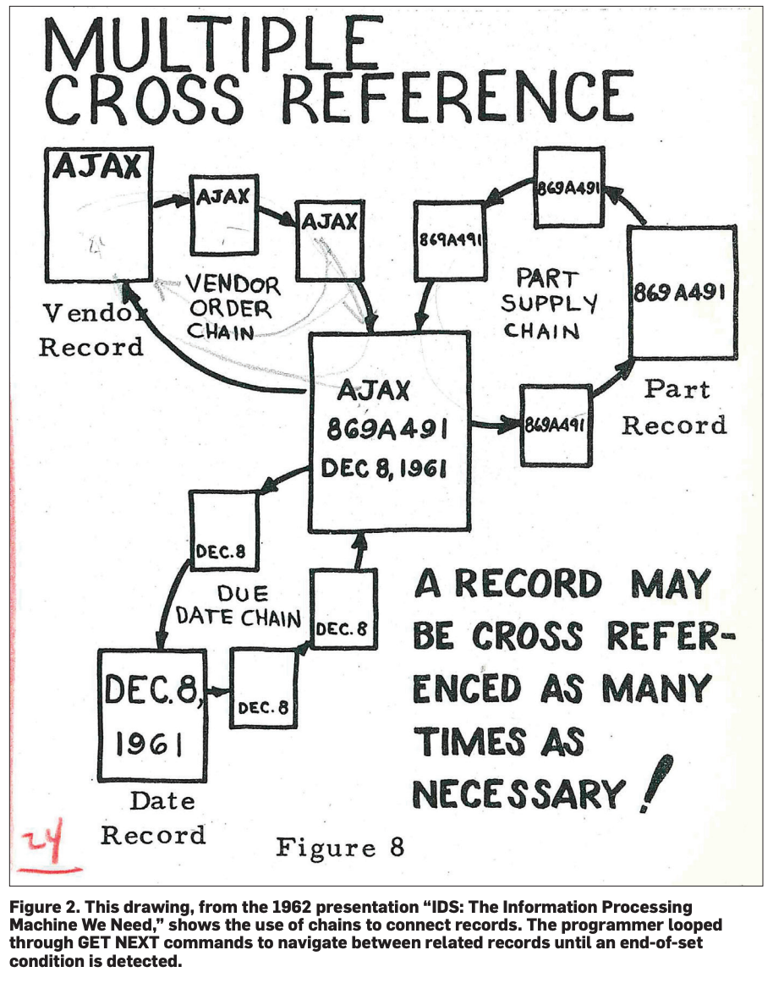
A 1962 Drawing of IDS’s Network Model

Slide 27
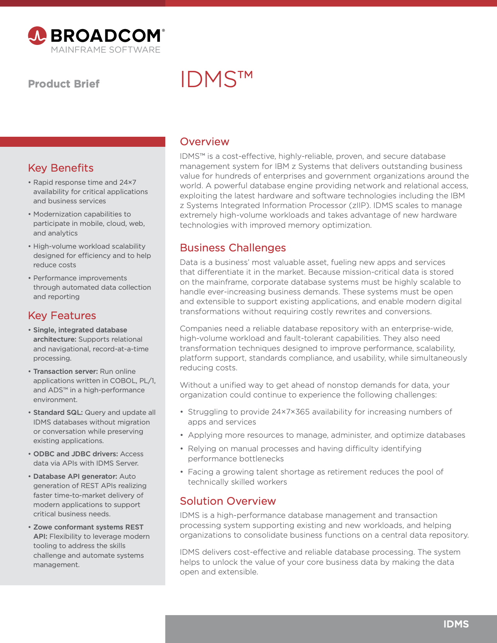
Timeline of IDS commercialization
Bought by
CA Technologies
(gets a SQL frontend)
Developed @ GE by Bachman et al.
IDS
Rewritten for IBM mainframes by B.F. Goodrich Company
IDMS
Bought by
Cullinane Co.
Bought by
Broadcom
1961-64
late 1960s
1970s
1989
2018

Slide 28
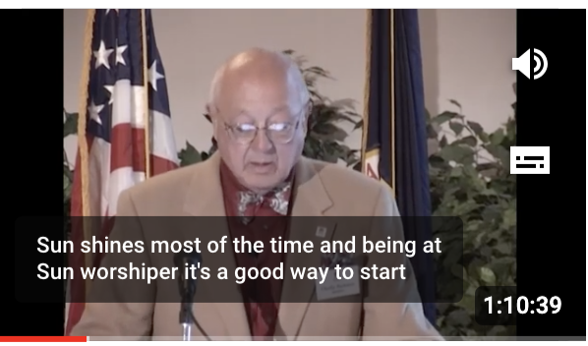
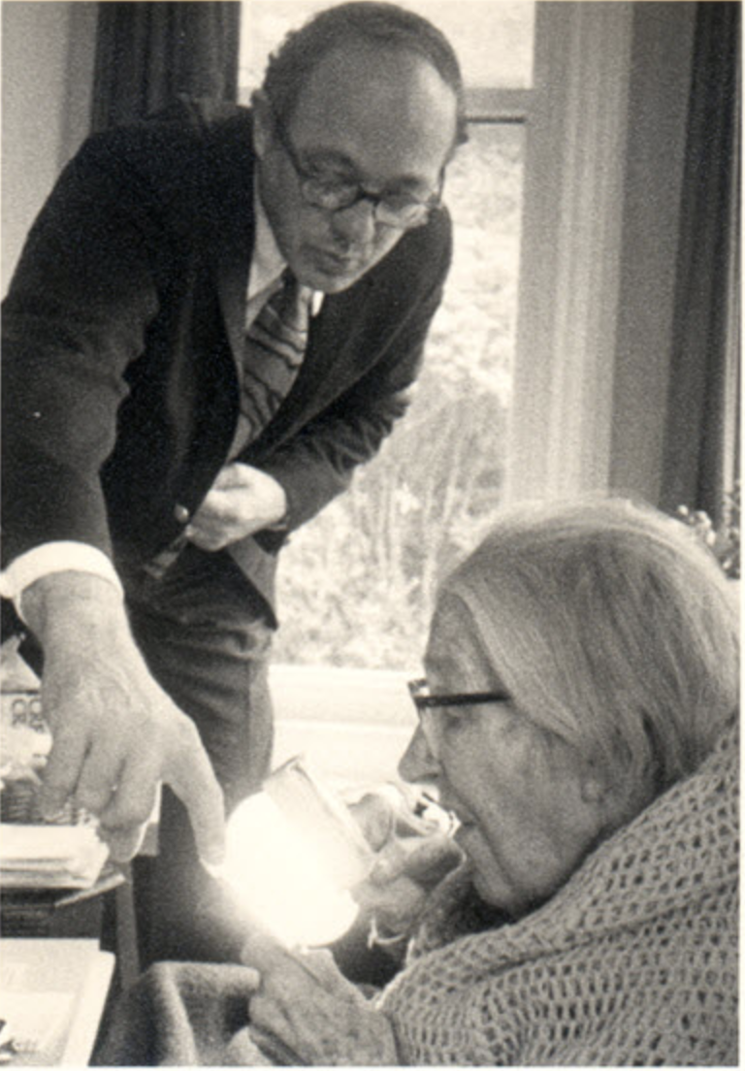
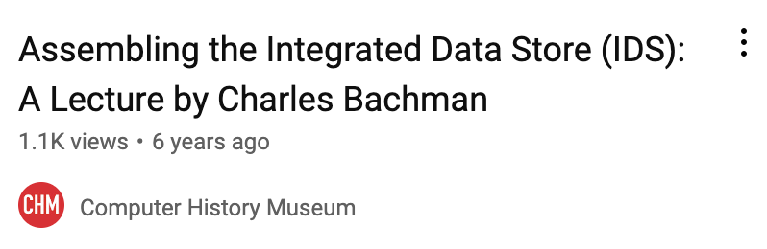
Charles Bachman Anecdote
1973 Turing Award: one of few engineers & not researchers to receive the award
Anecdote: Doesn’t know who Turing is when given the award
https://youtu.be/iDVsNqFEkB0
Charles Bachman & Sara Turing 1974

Slide 29
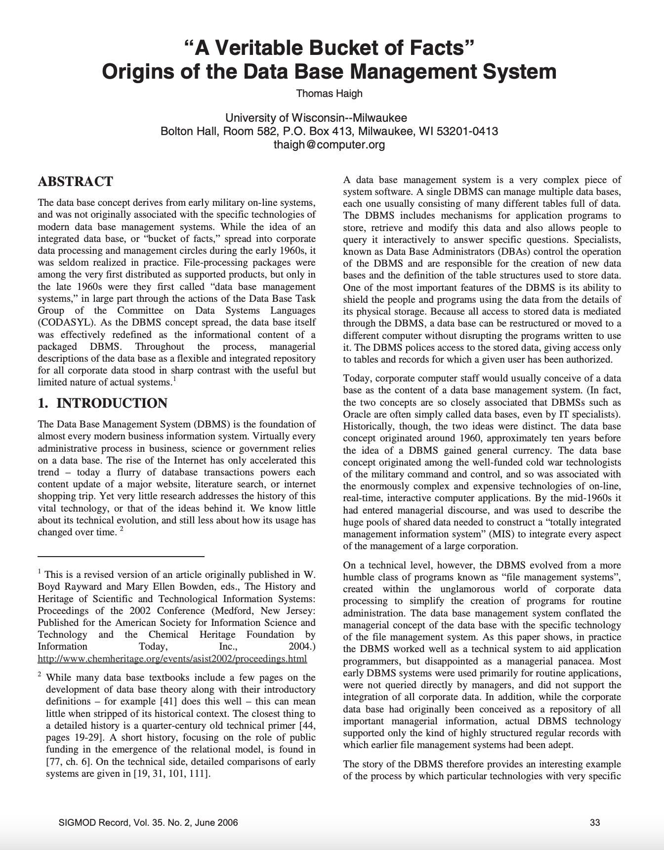
Must-read Paper on the Birth of DBMSs

Slide 30
2. Techniques for Recursive Join Queries
Kùzu/Neo4j:
EXPLAIN MATCH (a:Accnt)-[:Transfer* SHORTEST]->(b:Accnt)
WHERE a.location=Canada AND b.owner=Alice
RETURN *
Output Writer
Shortest Paths
Scan

Slide 31
3. Techniques for Many-to-Many Joins
MATCH (a)-[:]->(b)-[:]->(c)
WHERE b.name=‘Liz’
RETURN a.ID, c.ID
U₁
C₁
…
…
L₁
…
…
U₁₀₀
C₁₀₀
…
…
L₂
…
…
Example technique:
U₁₉₉
C₁₉₉
Traditional Systems
Kùzu’s Factorized Representation
b | name | a | c
L₁ | Liz | U₁ | C₁
 | … | … | …
L₁ | Liz | U₁ | C₁₀₀
L₂ | Liz | U₁₀₀ | C₁₀₀
… | … | … | …
L₂ | Liz | U₁₉₉ | C₁₀₀
b, name |  | a |  | c
{L₁, Liz} | X | {U_{1,}…, U₁₀₀} | X | {C₁, …, C₁₀₀}
U
{L₂, Liz} | X | {U_{100,}…, U₁₉₉} | X | {C₁₀₀, …, C₁₉₉}
2x(100+100) tuples
More in the other sessions
2x100x100 tuples

Slide 32
Property Graphs History
Neo4j’s data model. Founded in 2000; first offering in 2007
Frustration of developing an ECM system on RDBMSs
Ex: writing complicated joins
Property graph model + Cypher
labels
&
properties
labels
&
properties
MATCH (a:Account)-[t:eTransfer*]->(b:Account)
WHERE a.owner = Alice
RETURN b.owner, average(t.amount) AS avg
labels & attributes

Slide 33
A Lightning Fast History of DBMSs
Integrated Data Store (IDS)
Information
Management System
(IMS)
Ted Codd’s Relational Model
(System R)
Larry Ellison’s Oracle RDBMS
Stonebraker’s Ingres/Postgres RDBMS
1960s
1970s
1980s
2020s
2010s
2000s
1990s
Vector
DBMSs ?
Document-oriented DBMSs
RDF DBMSs
Columnar/OLAP
RDBMSs
Object Oriented DBMSs
Property Graph DBMSs
XML DBMSs

Slide 34
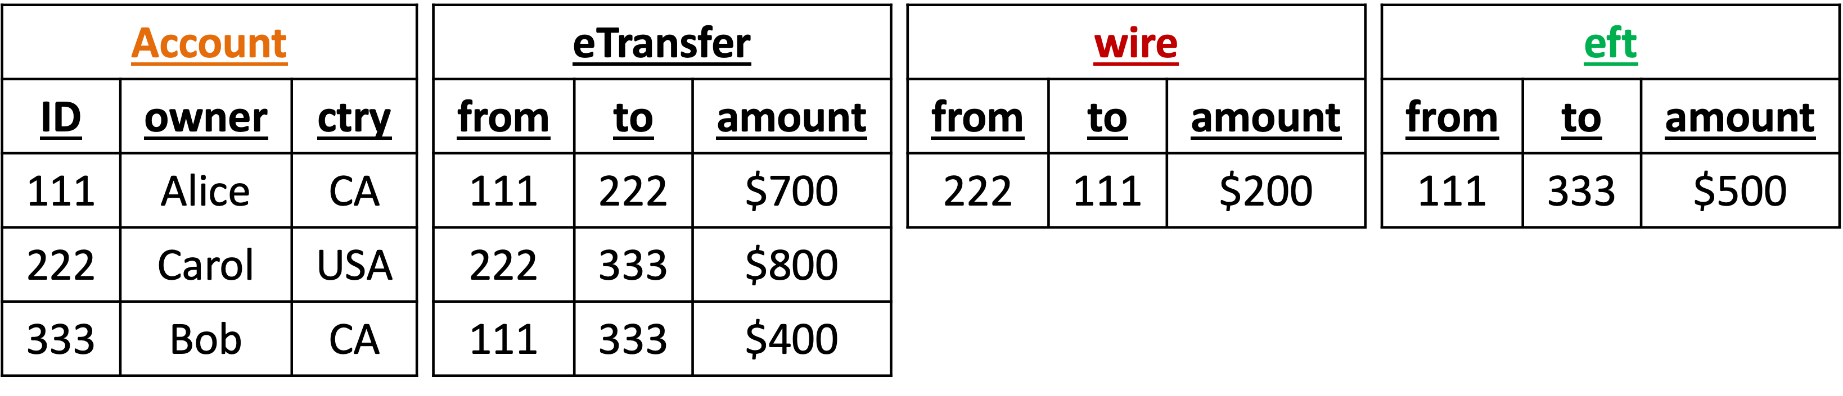
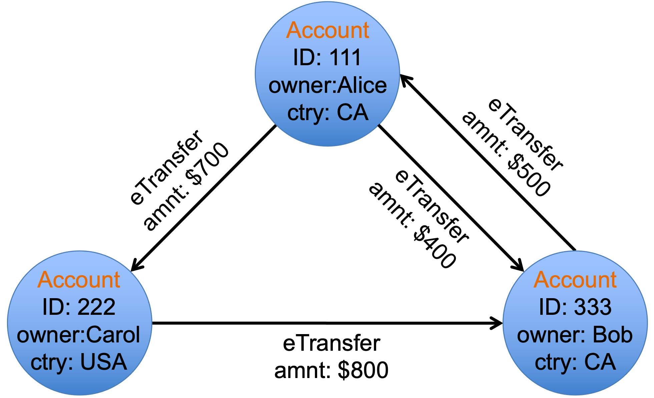
Property Graphs History
Positions directly as “graph databases”
Very simple model + generic
Familiar and elegant query language:
Closest to the relational model & SQL

Slide 35
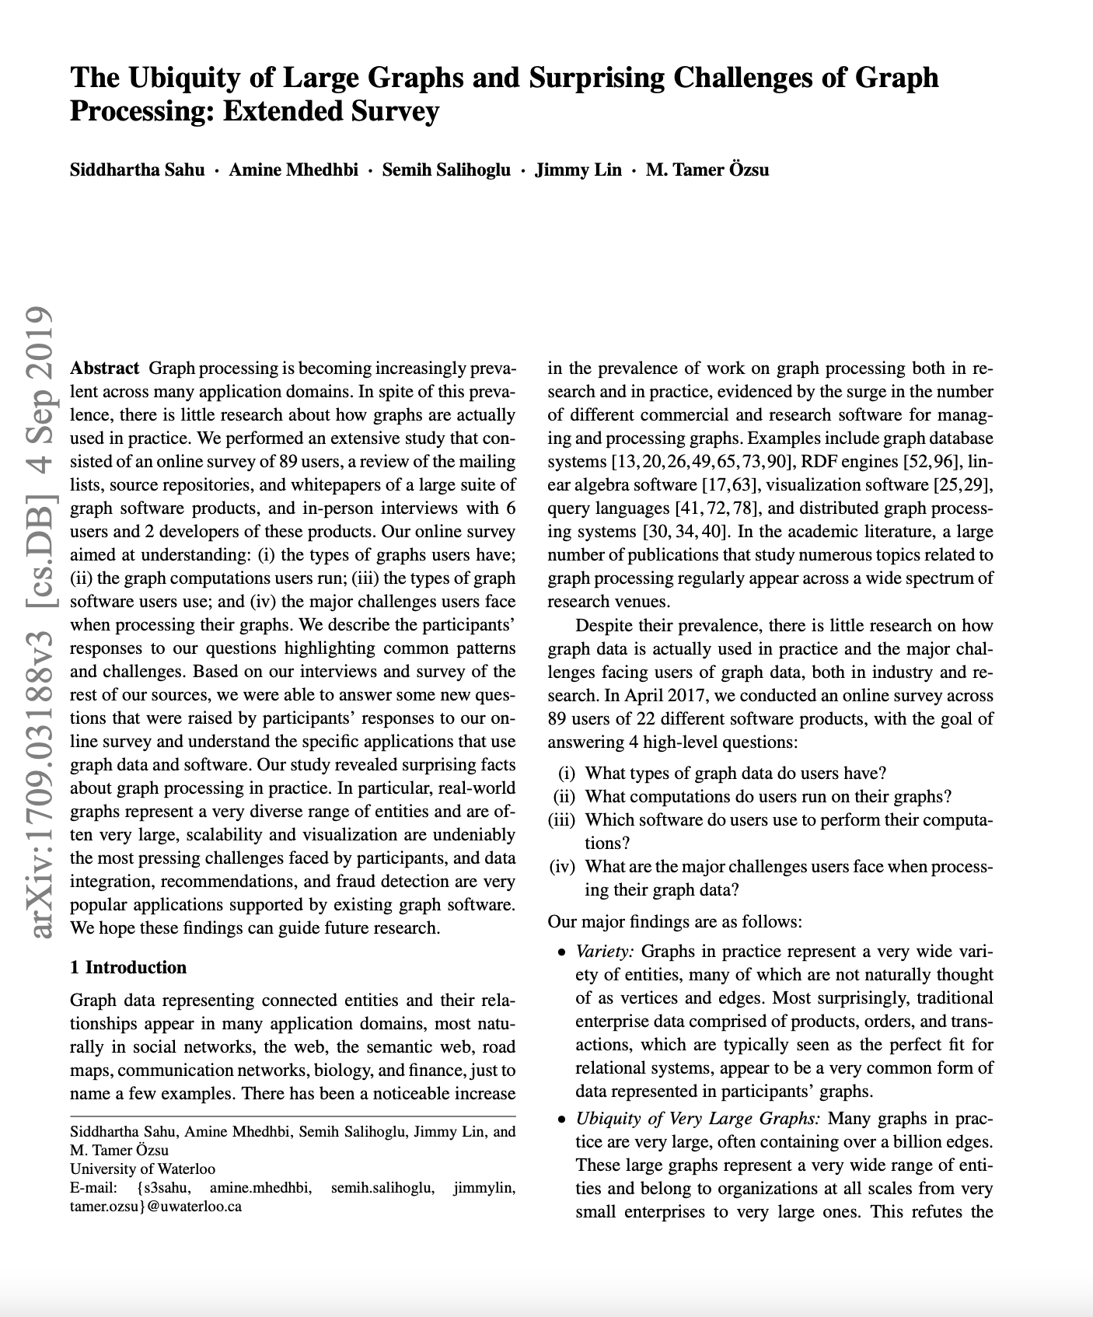
Property Graphs History
17 years later: foundation of the standards coming up
GQL: https://www.gqlstandards.org/
SQL/PGQ: https://www.iso.org/standard/79473.html
VLDB 2018, VLDBJ 2019

Slide 36
Outline
Property Graphs Overview
RDF Overview

Slide 37


Kùzu Vision
Perfect the previous feature set that differentiate GDBMSs from RDBMSs
Highly scalable: several TBs on SSDs
Very fast querying
/ in terms of usage (think “DuckDB for graphs”)
Open-sourced under MIT Licence
Kùzu aims to represent the state-of-the-art knowledge of how graphs should be stored, indexed, and queried.

Slide 38




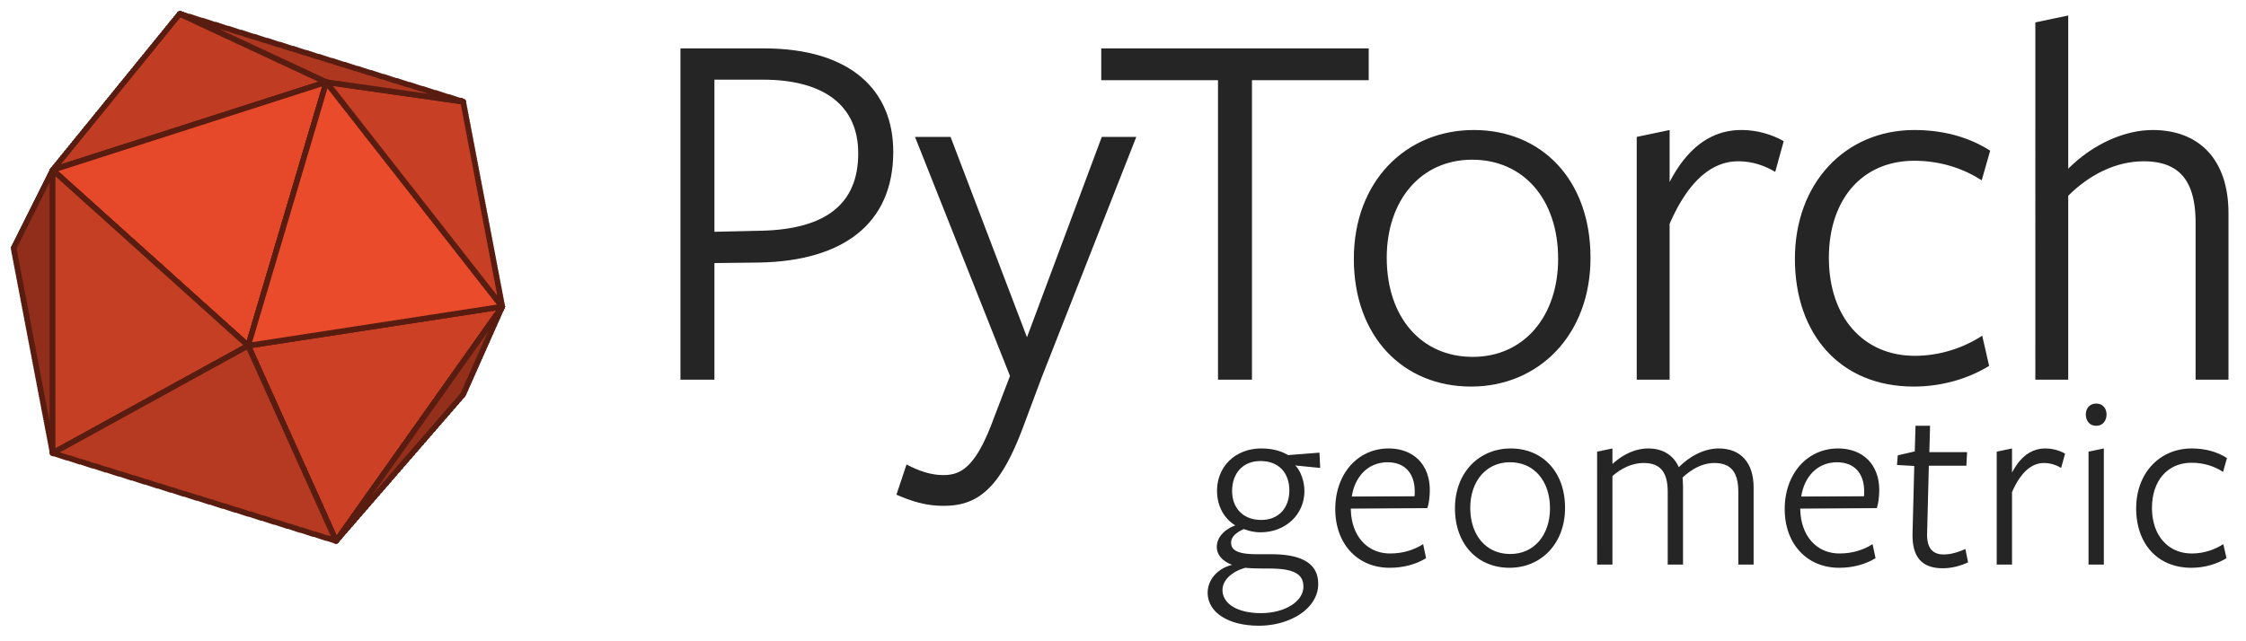

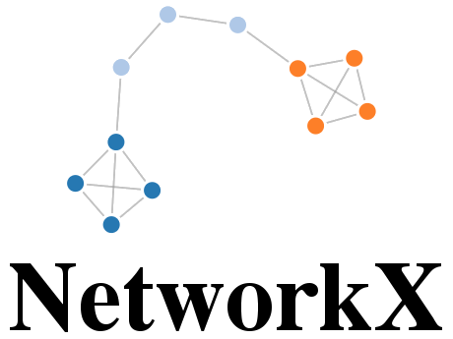


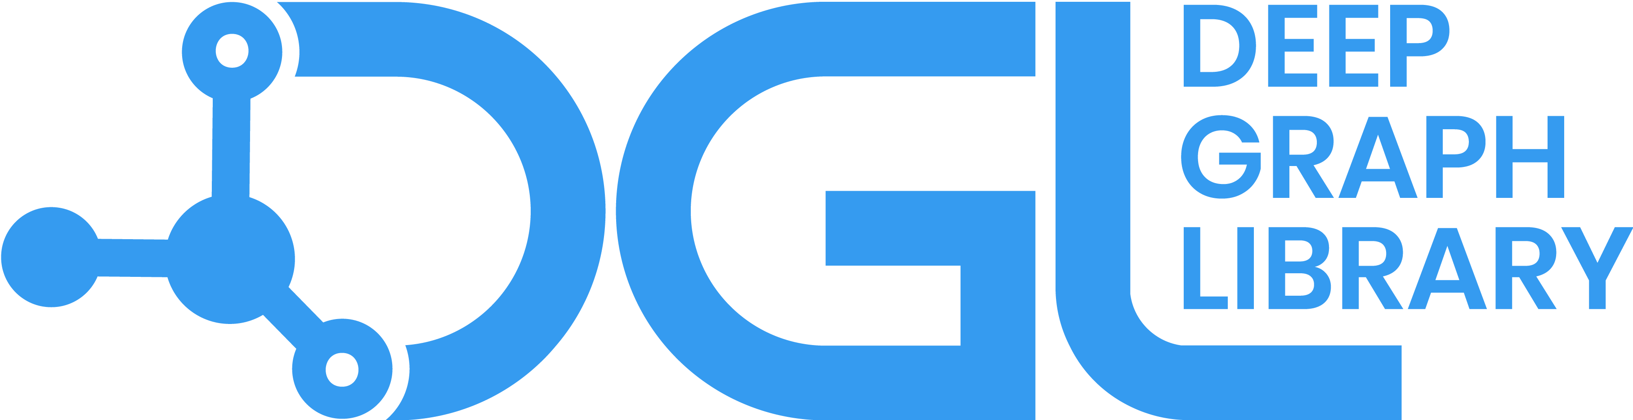
Kùzu in Broader Graph Management & Processing Systems Space
Property Graph DBMSs
RDF Systems
core features
tight integrations
Graph Analytics Systems
Graph Visualization Software

Slide 39
Kùzu Current Usability Features
Property Graph Data Model & Cypher query language
RDFGraphs: Automatic mapping of RDF triples to property graphs
DuckDB/SQLite-like embeddable in apps
pip install kuzu
Serializable transactions, i.e., atomic & durable
import kuzu
db = kuzu.database('./testdb’)
conn = kuzu.connection(db)
results = conn.execute('MATCH (u:User) RETURN u.name;’)
while results.hasNext():
print(results.getNext())

Slide 40
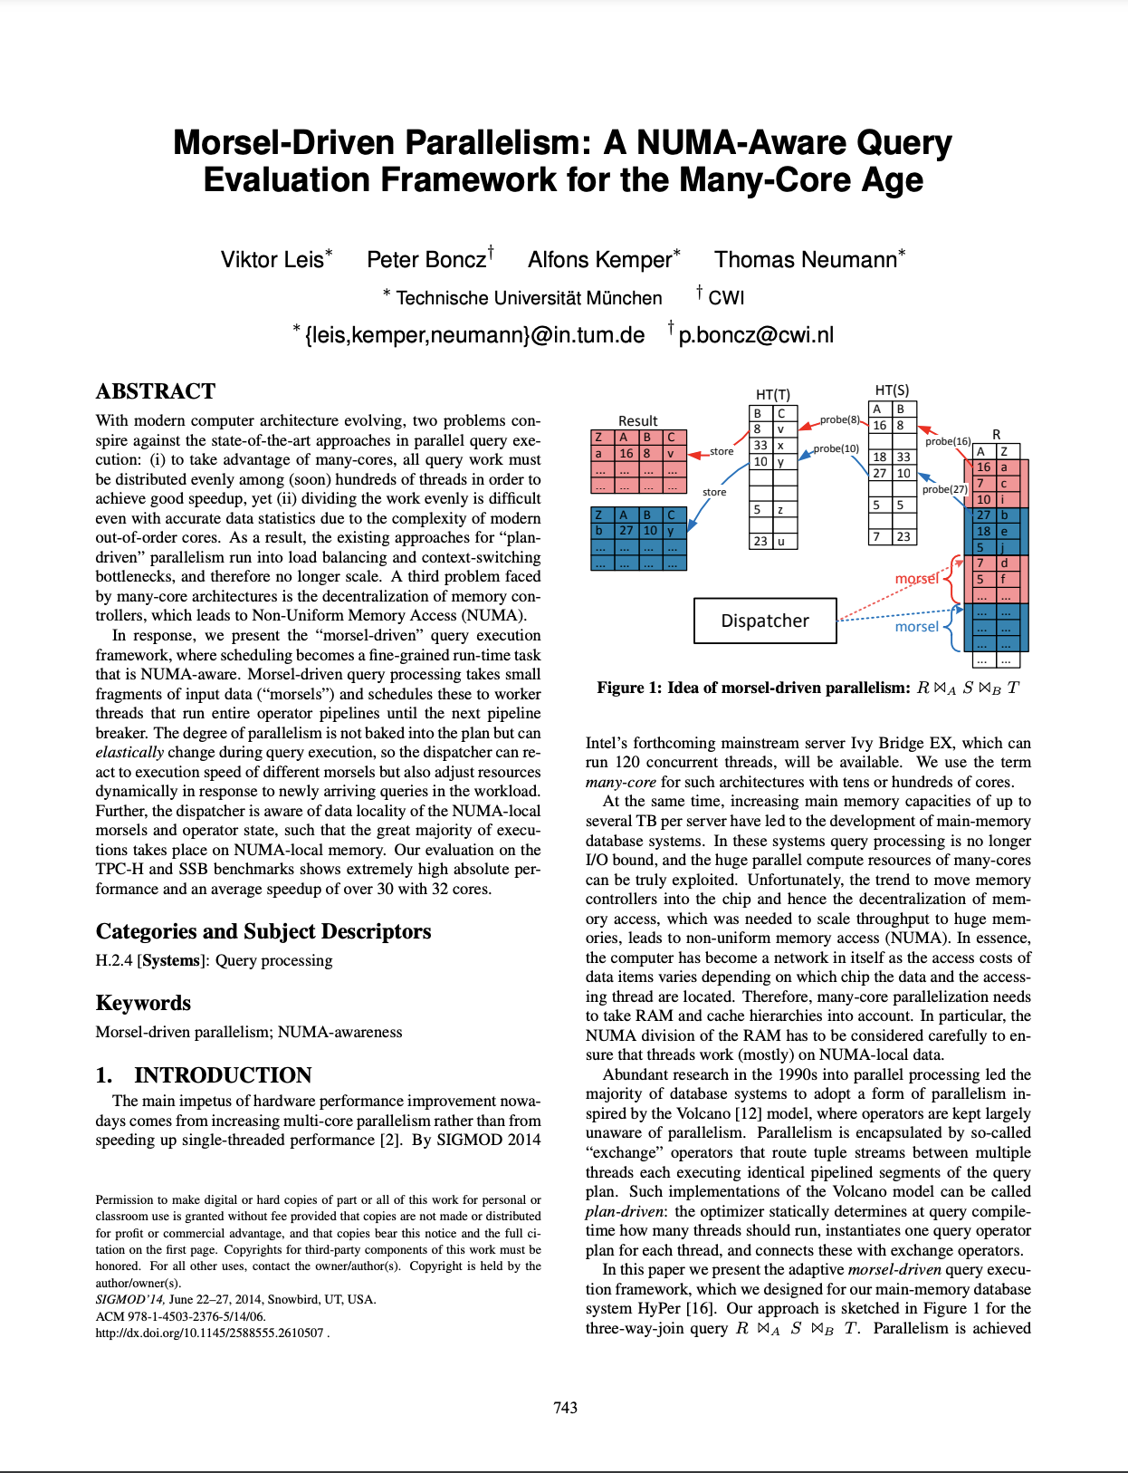
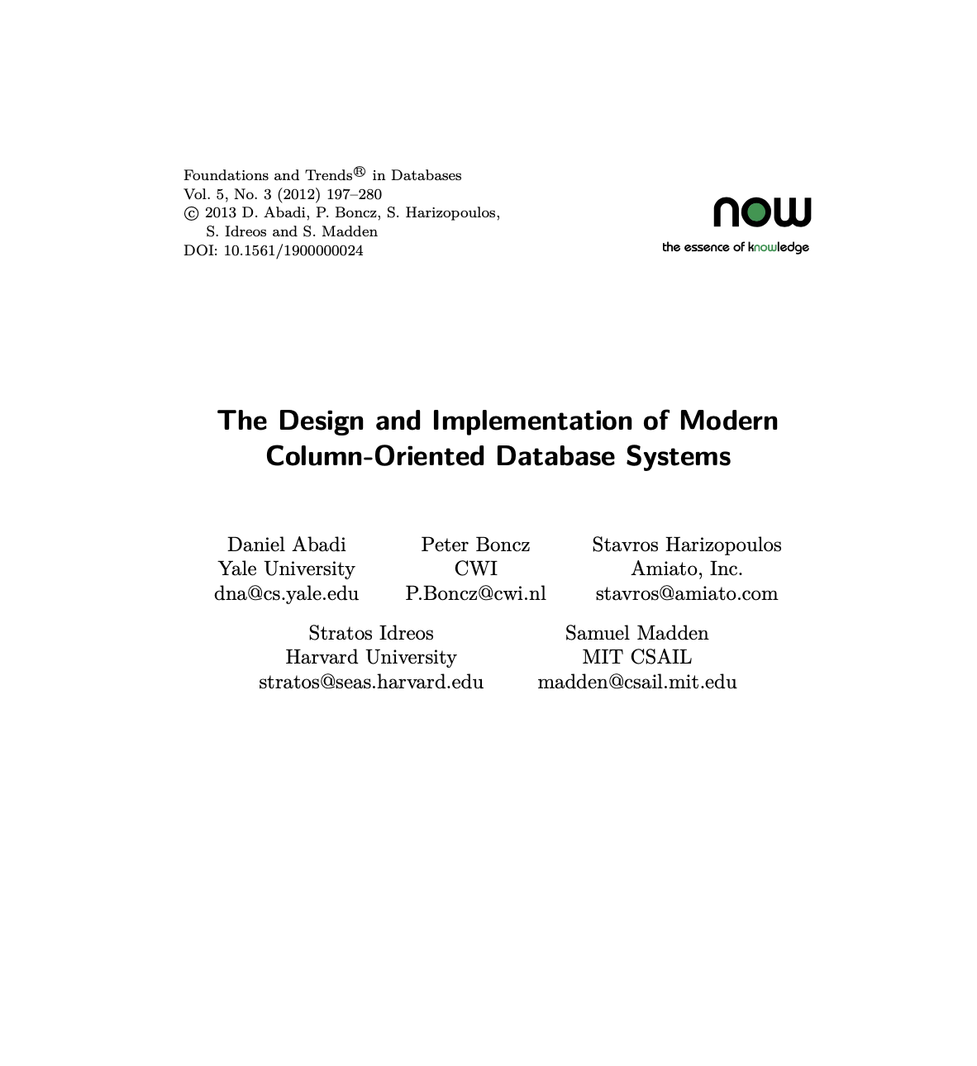
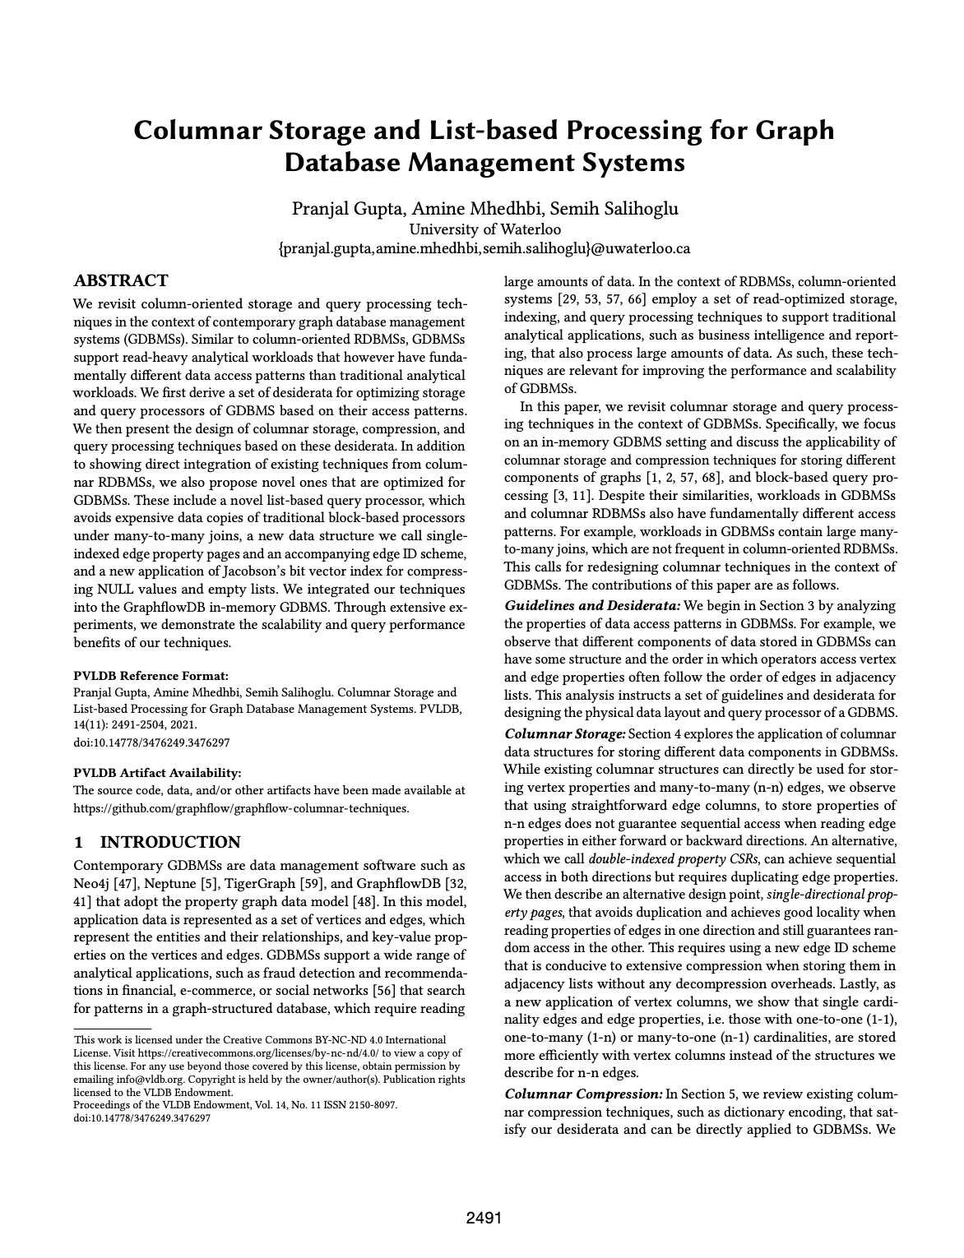
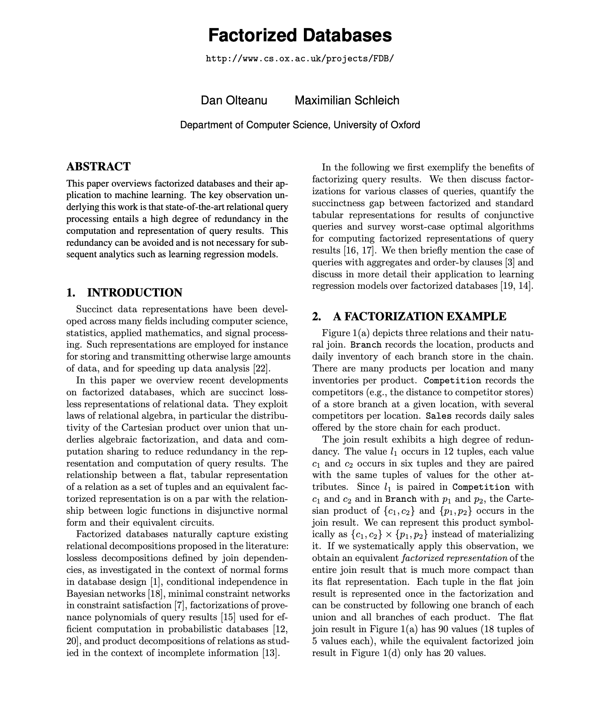
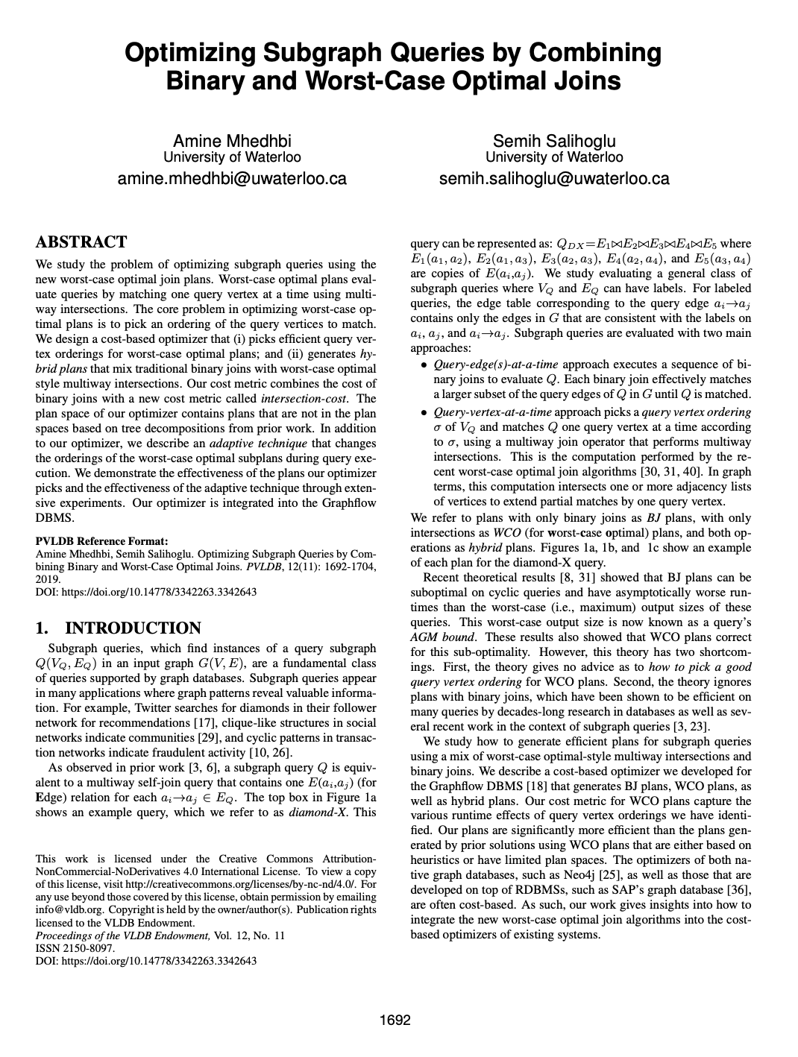
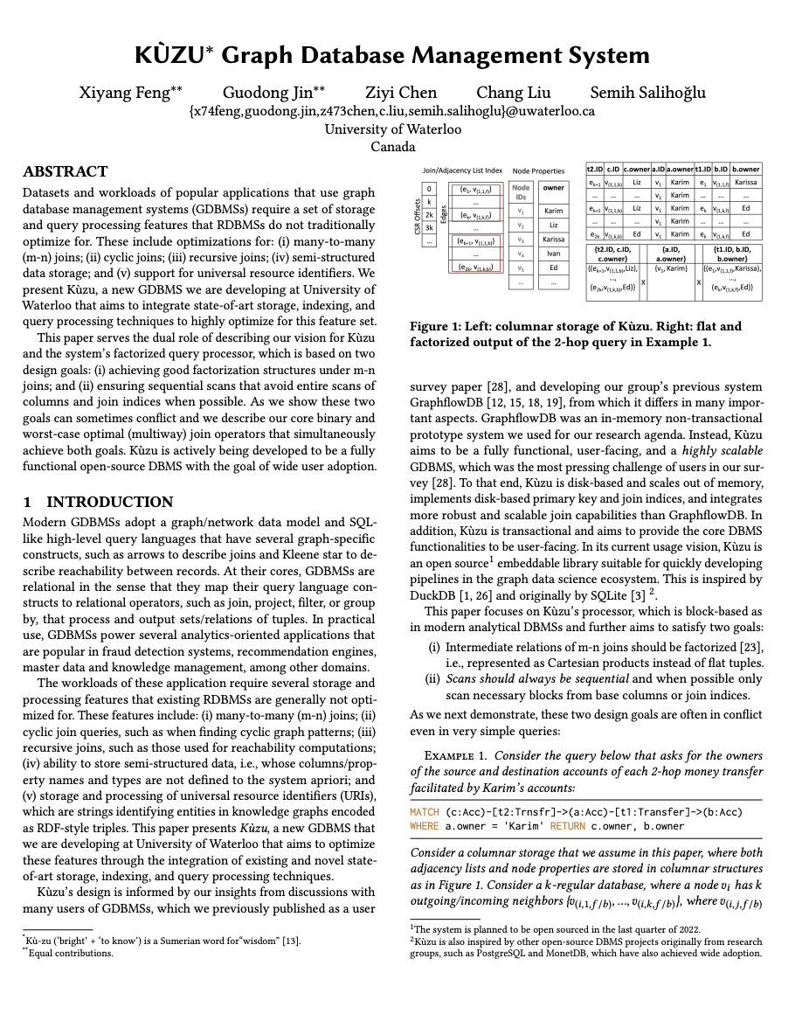
Kùzu Current Performance Features
Vectorization
Factorization
Morsel-driven Parallelism
Scans are “morselized” across threads
Scan Node
Filter
a.ID < 10
b, name |  | a |  | c
{L₁, Liz} | X | {U_{1,}…,U₁₀₀} | X | {C₁, …, C₁₀₀}
U
{L₂, Liz} | X | {U_{100,}…,U₁₉₉} | X | {C₁₀₀,…,C₁₉₉}
d
e
f
d
d
Novel Join Algorithms
Disk-based Columnar Storage
Disk-based Hash Index
e
f
e
f
e
f
keys
hash func.
000 | Karim
001
010 | Alice
011 | Noura
…
slots
Alice
Noura
node properties
CSR-based join indices & edge props
Karim

